Slide 1
Transition
CSS transitions allows you to change property values smoothly, over a given duration.

Slide 2
!important
The !important rule in CSS is used to add more importance to a property/value than normal.
In fact, if you use the !important rule, it will override ALL previous styling rules for that specific property on that element!

Slide 3
The Margin Collapse
Top and bottom margins of elements are sometimes collapsed into a single margin that is equal to the largest of the two margins.
This does not happen on left and right margins! Only top and bottom margins!

Slide 4
CSS Variables And Trainings
The var() function is used to insert the value of a CSS variable.
CSS variables have access to the DOM, which means that you can create variables with local or global scope, change the variables with JavaScript, and change the variables based on media queries.
A good way to use CSS variables is when it comes to the colors of your design. Instead of copy and paste the same colors over and over again, you can place them in variables.

Slide 5
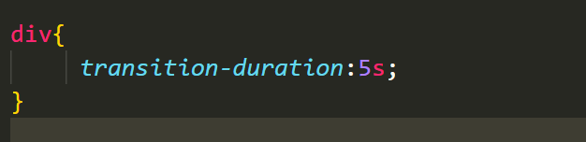
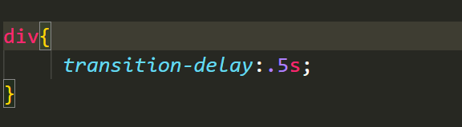
Transition
transition-duration:1s;
-----------------------------------------------------
transition-delay:2s;

Slide 6
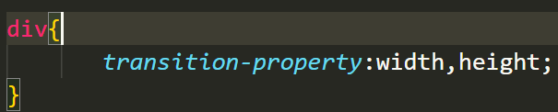
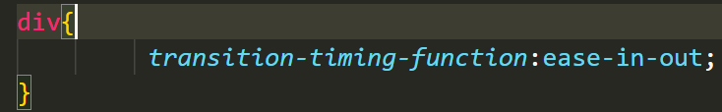
transition-property: all;
transition-property:width,height;
https://developer.mozilla.org/en-US/docs/Web/CSS/CSS_animated_properties
_________________________________
transition-timing-function:ease;
-linear; -ease-in; -ease-out; ease-in-out;
___________________________________________

Slide 7
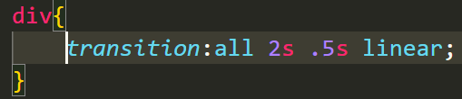
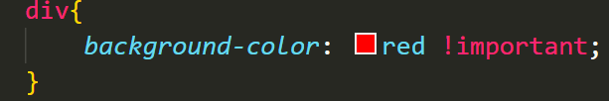
!important
transition:all .5s 2s linear;
property duration delay timing-function

Slide 8
The Margin Collapse
1 – Only vertical margin collapse.
2 – Bigger Margin Wins.
3 – Margin collapsing with elements without anything between.
4 – Nesting does not prevent collapsing.

Slide 9
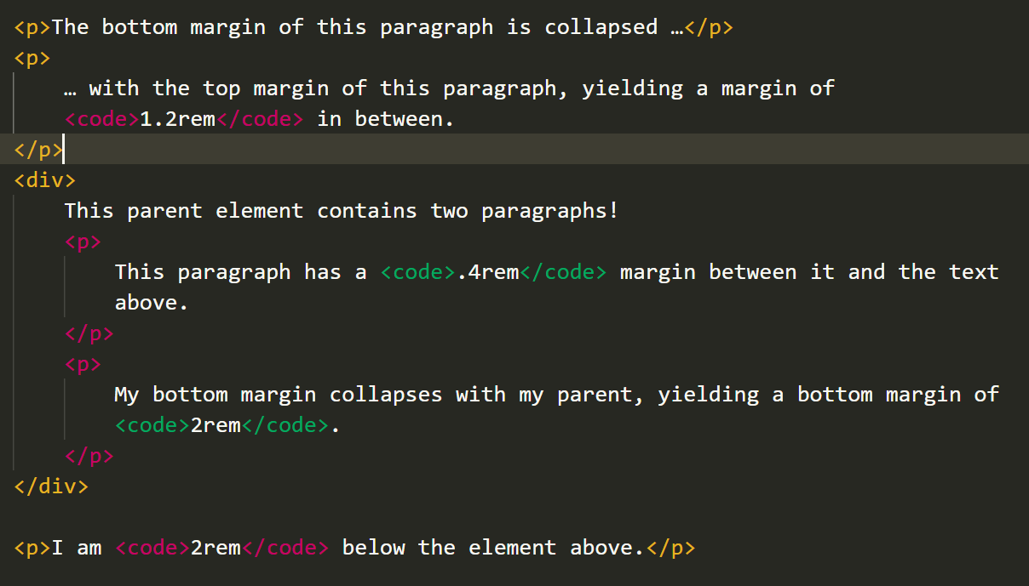
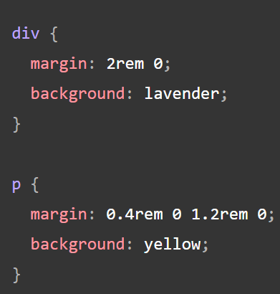
https://developer.mozilla.org/en-US/docs/Web/CSS/CSS_Box_Model/Mastering_margin_collapsing

Slide 10
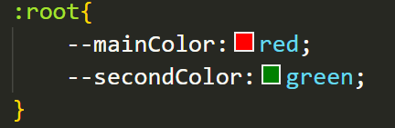
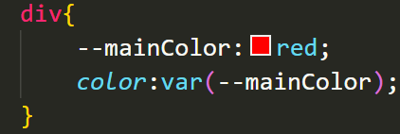
CSS Variables
Global
Local

Slide 11
Flex Box
The Flexible Box Layout Module, makes it easier to design flexible responsive layout structure without using float or positioning.
To start using the Flexbox model, you need to first define a flex Container and Items.

Slide 12
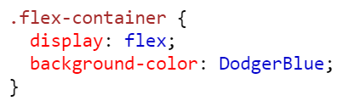
Flex container :
_The flex container becomes flexible by setting the display property to flex

Slide 13
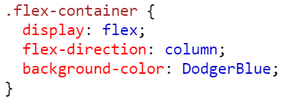
flex-direction
The flex-direction property defines in which direction the container wants to stack the flex items.

Slide 14
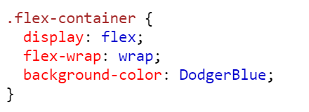
flex-wrap
The flex-wrap property specifies whether the flex items should wrap or not.

Slide 15
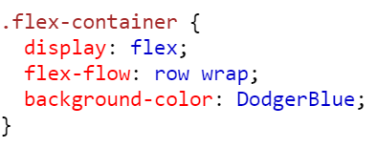
flex-flow
The flex-flow property is a shorthand property for setting both the flex-direction and flex-wrap properties.

Slide 16
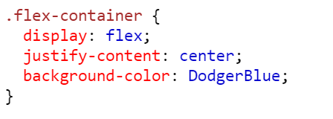
justify-content
The justify-content property is used to align the flex items

Slide 17
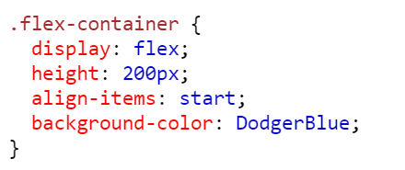
align-items
The align-items property is used to align the flex items.

Slide 18
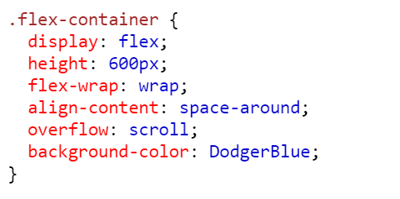
align-content
The align-content property is used to align the flex lines.

Slide 19
The align-content property is used to align the flex lines.

Slide 20
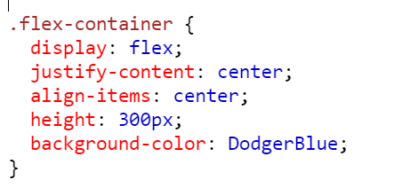
Perfect Centering
Set both the justify-content and align-items properties to center, and the flex item will be perfectly centered:

Slide 21
Anytime I’m involved with anything that’s well-received, it’s a surprise to me.
Larry David

Slide 22
Anytime I’m involved with anything that’s well-received, it’s a surprise to me.
Larry David

Slide 23
Anytime I’m involved with anything that’s well-received, it’s a surprise to me.
Larry David

Slide 24
Anytime I’m involved with anything that’s well-received, it’s a surprise to me.
Larry David

Slide 25
Thank you

